Slide 1


Exploring the endangered species in U.S. National Parks
Team TAMA
January 8, 2020

Slide 2





The National Park Service currently oversees 61 sites covering over 85 million acres comprising of parks, national monuments, battlefields, seashore, recreational and cultural sites.
The definition of an endangered species is a wild animal or plant that has been categorized by the International Union for Conservation of Nature (IUCN) to potentially become extinct in the near future.

Slide 3


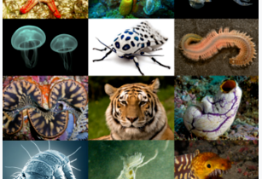
The U.S. National Parks list of endangered species include Mammal, Bird, Fish, Reptile, Slug/Snail, Amphibian, Insect, Spider/Scorpion, Fungi, Crab/Lobster/Shrimp and Invertebrate
WebScraping & Database
Resource information was obtained from Kaggle and Data World
Park and Species-specific csv data was loaded into SQLite database.
SQLite Studio was used to create tables and merge the data points
Lastly visitor information from a third json source was loaded into SQLite

Slide 4


Deployment Process
Created API endpoints in Flask; Used API and JavaScript to load the data from SQLite; Converted json data into geojson format;
SQLite

Slide 5

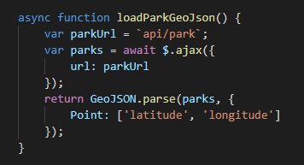

Used JQuery to simplify the Ajax interactions using the Async/Await technique

Slide 6



Created interactive map using Leaflet
Finally leaned on our resident expert to deploy using Heroku

Slide 7
Access to Team TAMA Website
https://nps-bio.herokuapp.com/#

